Slide 1
AI BASED ATTENDANCE SYSTEM
Submitted to
Smt. Chandaben Mohanbhai Patel Institute Of Computer Application
Prepared By
Kaushal Adeshra (19BCA056)
Shivam Barot (19BCA057)
Harshil Suthar (19BCA058)
Guide By
Dr. Kanubhai Patel

Slide 2
Agenda
System Introduction
Aim of the system
Scope of the system
Tools/Technology used in system
Software Requirement Specification
Functionality
Functional Requirement
System Design
System Implementation
System Testing
Conclusion
Limitation and Future Enhancement
Reference

Slide 3
SYSTEM INTRODUCTION

Slide 4
Aim Of The System
This project aims to automate the traditional attendance system where the attendance is marked manually.
It also enables an organization to maintain its records like in-time, out time, break time and attendance digitally. Digitalization of the system would also help in better visualization of the data using graphs to display the no. of employees present today, total work hours of each employee and their break time. Its added features serve as an efficient upgrade and replacement over the traditional attendance system.

Slide 5
Scope Of The System
Facial recognition is becoming more prominent in our society. It has made major progress in the field of security. It is a very effective tool that can help low enforcers to recognize criminals and software companies are leveraging the technology to help users access the technology.
This technology can be further developed to be used in other avenues such as ATMs, accessing confidential files, or other sensitive materials.

Slide 6
Tools/Technology/Platform
Technology
Django
OpenCV
Dlib
Open-Source Face Recognition Library
SQLITE Database.
JavaScript
Bootstrap
Tools
PyCharm
Platform
Windows

Slide 7
Software Requirement Specification

Slide 8
Functionality
We have 2 types of user in the system
Employee
Admin
Following are the functionality which can be performed by Admin
Login
Register new employees to the system
Add employee photo to the training data set
Train the model
View attendance report of all employee. Attendance can be filtered by date or employee.

Slide 9
Following are the functionality which can be performed by Employee
Login
Mark his/her time-in and time-out by scanning their face
View the attendance report of themselves.

Slide 10
Functional Requirement

Slide 11
Manage Login and Registration
Register New Employee
Description: Admin can register new
Input: Employee Details
Output: success message displaying the user has been created.
Log into the system
Input: User credentials
Output: If the credentials are correct, user will be redirected to the dashboard of the system
Exception Flow: If the entered credentials are incorrect then user will be redirected to the login page again displaying an error message.

Slide 12
Manage Attendance Details
Mark your attendance-in
Input: User will scan his/her face using the external web camera.
Output: system will identify the user uniquely and will mark his/her in-time to the database. The same success message will be transmitted to the user.
Mark your attendance-out
Input: User will scan his/her face using the external web camera.
Output: system will identify the user uniquely and will mark his/her out-time to the database. The same success message will be transmitted to the user.

Slide 13
View my attendance report
Description: Employee may often need to see his / her attendance record throughout the month or year. Using this feature one can see his / her attendance record till the date.
Input: User selection
Output: Statistical analytics of the particular employee who is currently logged into the system will be displayed.
View employee’s attendance report
Description: This feature is for admin. Admin can monitor the availability of each employee till the date. i.e., how many employees are present today out of total employees etc. can be monitored.
Input: user selection
Output: Attendance record of each employee including how many employees are present today out of total along with the availability graph.

Slide 14
Manage Employee Details
Add photo of the employee
Description: Admin only can access this feature. Admin can add a photo of an employee during the registration process.
Input: Username of an employee
Output: Success message record has been added.
Process: System will process an image and will generate necessary system data to identify each employee uniquely.
Train the system
Input: user selection
Output: system will process all the available records of the employees and will generate necessary system data to identify each employee uniquely.

Slide 15
System Design

Slide 16
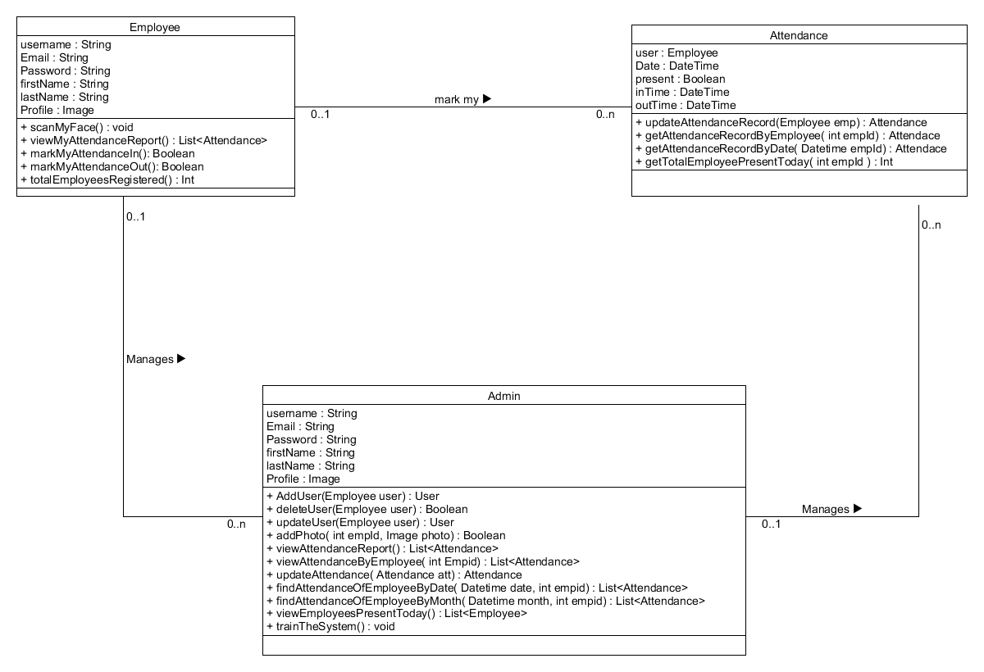
Class Diagram

Slide 17
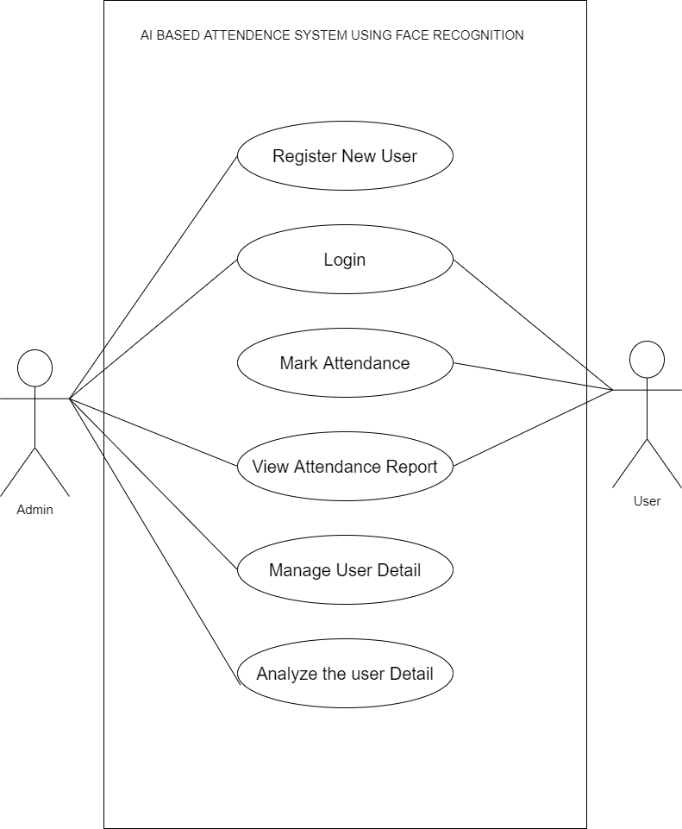
Use Case Diagram

Slide 18
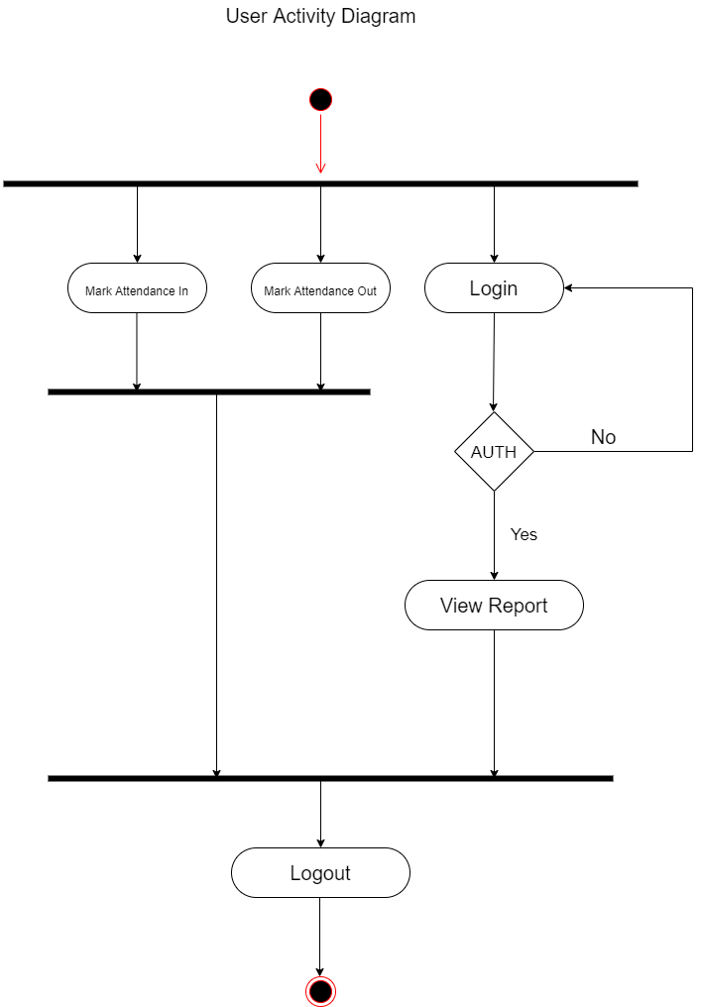
Activity Diagram

Slide 19
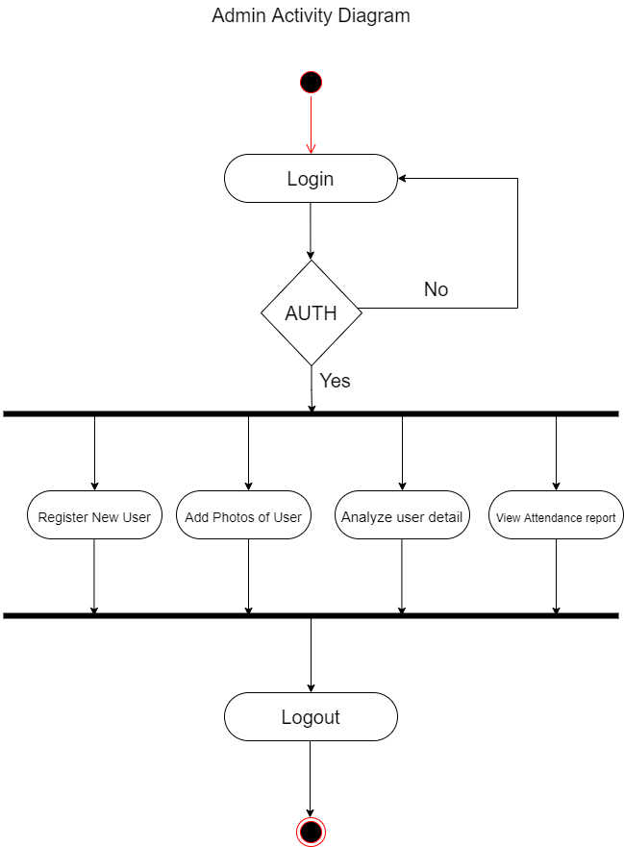

Slide 20
Data Dictionary
USER
NO | Field Name | Data Type | Required | Unique | PK/Fk | Ref.Table
1 | UserID | Int | True | True | PK | -
2 | Email | String | True | True | - | -
3 | Name | String | True | False | - | -
4 | Password | String | True | False | - | -
5 | CreateAt | Datetime | True | False | - | -
7 | UpdateAt | Datetime | true | False | - | -

Slide 21
Present
No | Field name | Data type | Required | Unique | PK/Fk | Ref.Table
1 | Pid | Int | true | True | PK | -
2 | Date | Datetime | True | False | - | -
3 | User | User | True | False | FK | Users
4 | Present | Boolean | true | false | - | -

Slide 22
Time
No | Field name | Data type | Required | Unique | PK/Fk | Ref.Table
1 | Tid | Int | True | true | PK | -
2 | Date | Datetime | True | True | - | -
3 | User | Users | True | False | FK | Users
4 | Time | Datetime | False | False | - | -
5 | out | Boolean | True | False | - | -

Slide 23
System Implementation

Slide 24
Modules
Registration and login modules
This module mainly deals with the functionalities related to the registration of any new employee to the organization, Log into the system and managing employee’s profile details. Using features provided by this module admin can register new employee to the system and admin / employee both can log into the system using their credentials.

Slide 25
Manage Attendance Details
This module mainly deals with the features related to the employee’s attendance. Using this employee can mark their presence, time-in and time-out in the system. Admin can see the availability report of each employee, employee can see his/her attendance report along with some possible filters such as filter by employee and filter by date.

Slide 26
Manage Employee Details
This module mainly deals with the features related to the employee’s profile. Using this admin can add a photo of the newly registered employee during registration. Admin can also command the system explicitly to train the model and system will make necessary calculation and will generate some data which will be used internally to identify each employee uniquely.

Slide 27
Function prototypes which implement major functionality
List<Attendance> viewMyAttendanceReport(int empId);
Int totalEmployeesRegistered();
List<Attendance> getAttendanceRecordByEmployee(int empid);
Boolean updateAttendanceRecord(int empid, Attendance update);
Boolean registerEmployee(Employee new_employee);
Boolean addPhoto( int empId, string photo);

Slide 28
System Testing

Slide 29
Unit testing of each module was done after successfully completing the module. Each module was tested individually before integrating them with the whole system.
After integrating each module with the system, integration testing was done in order to check if modules are working properly together.
After completing all integrations, black-box testing of the whole system was carried out to ensure the system works in a correct manner.

Slide 30
Black box testing of Major functions of the system
Log in to the system.
Case 1: Invalid Username or password entered by the user.
Output: Error message on the screen saying “Invalid credentials”
Case 2: Valid credentials.
Output: The user is redirected to the Dashboard page.

Slide 31
Update Profile
Case 1: username already exists.
Output: Error message on the screen saying “Username already exists”
Case 2: Some of required fields missing in input.
Output: Model validation errors will be displayed to the user.
Case 3: All input data are valid.
Output: Profile updated successfully.

Slide 32
View Attendance.
Case 1: User is not logged in.
Output: Redirected to the login page with error message “Please login!”.
Case 2: If a user exists and has the attendance records.
Output: All the chat history will be displayed
Case 3: Provided username does not exists in the system.
Output: 404 Error.

Slide 33
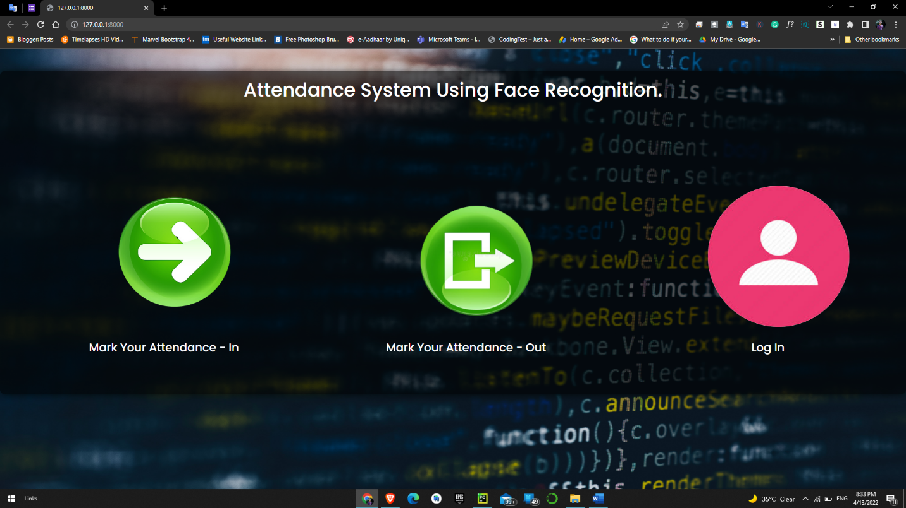
Screenshots
Login

Slide 34
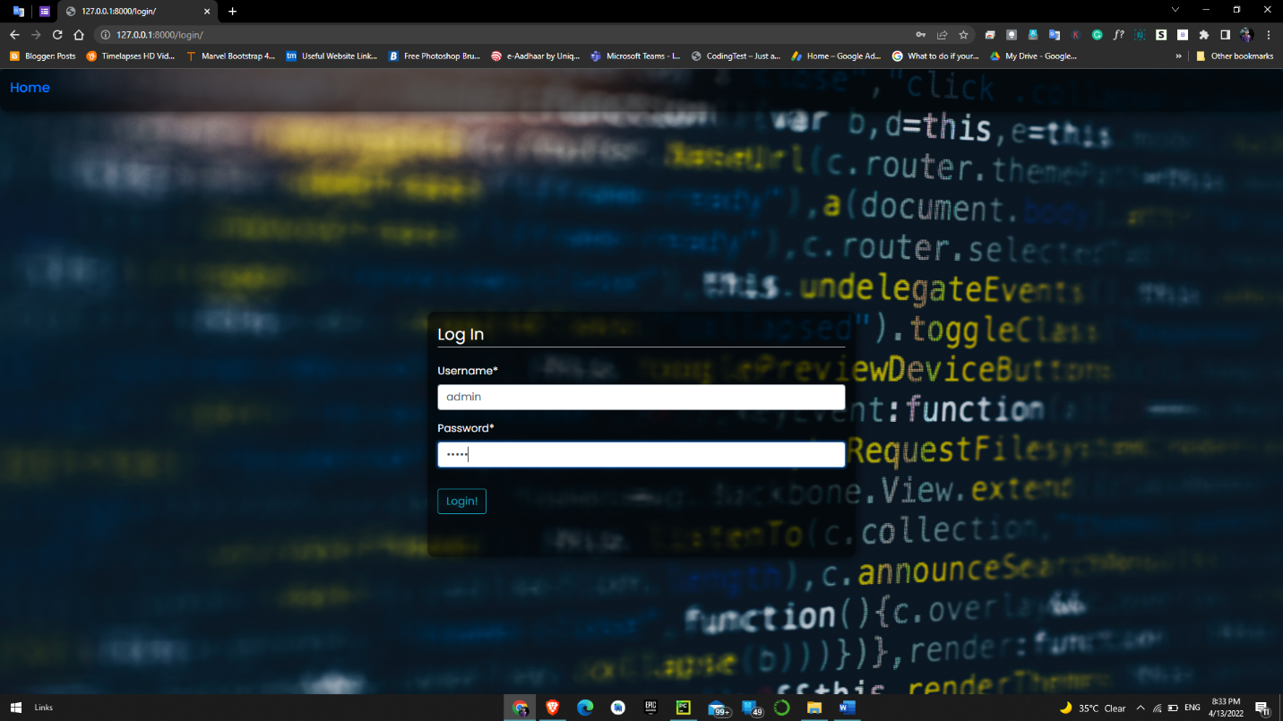

Slide 35
Mark my attendance In / Out

Slide 36
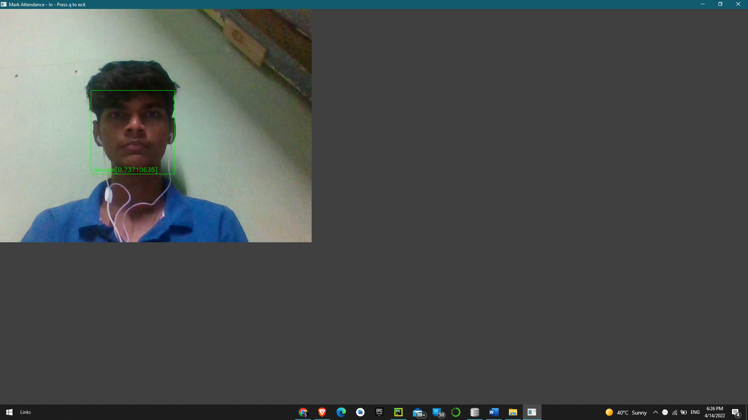
Scanning Face

Slide 37
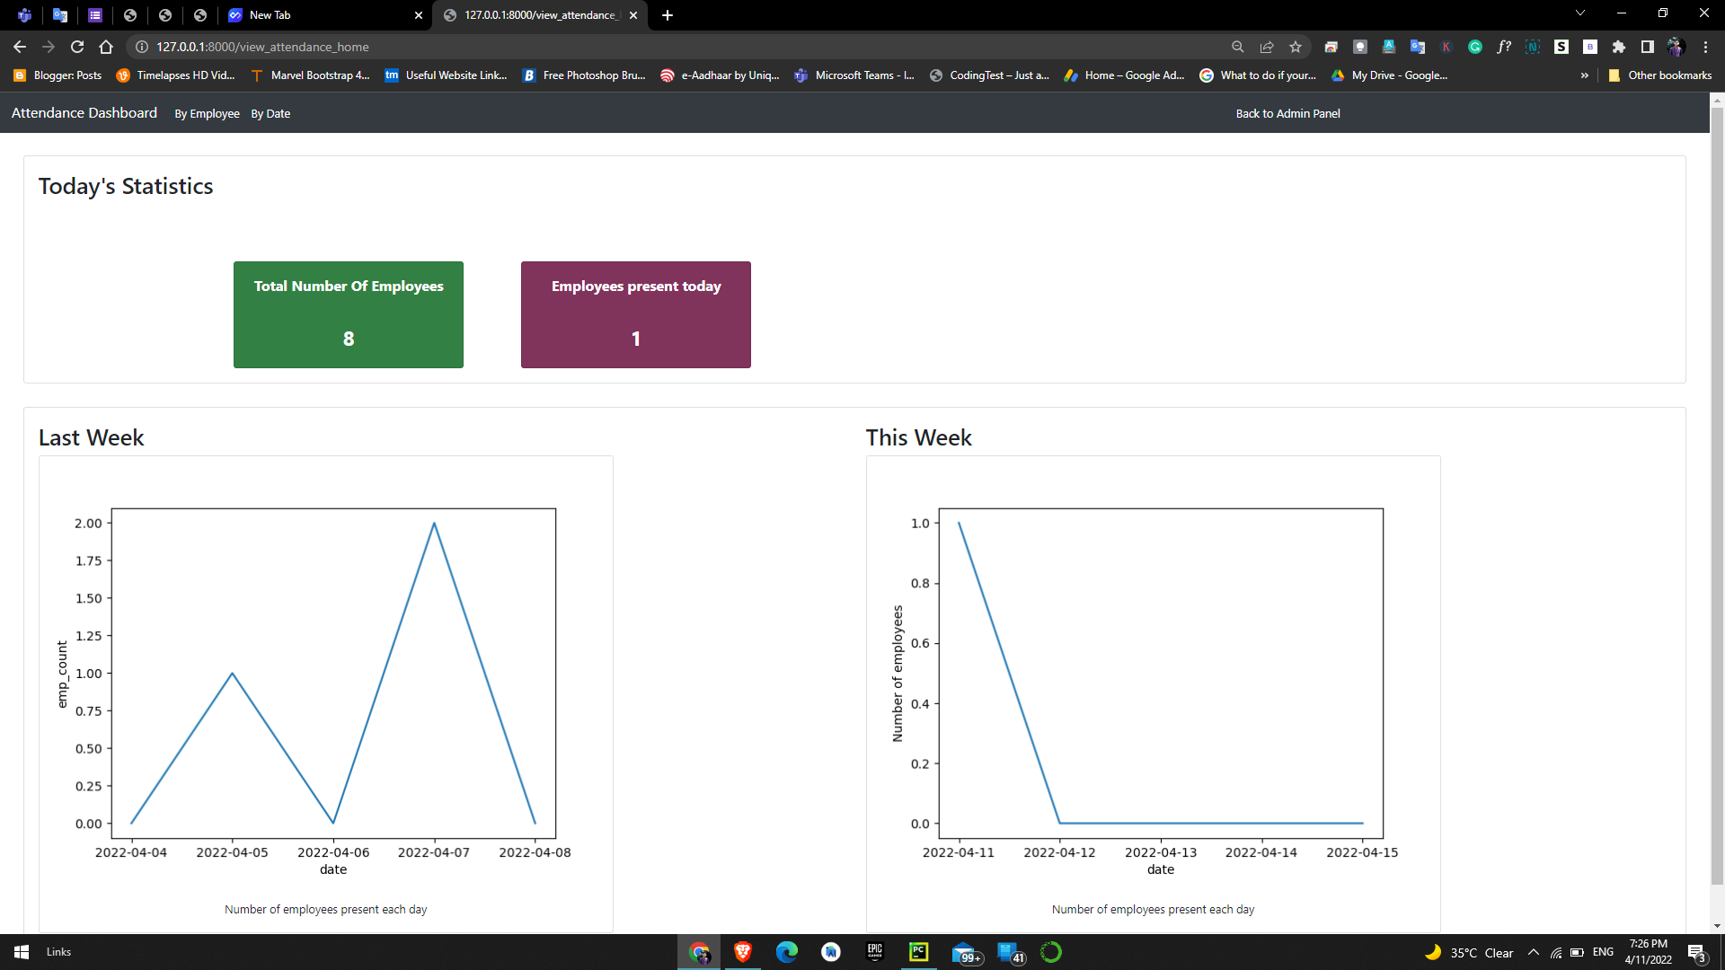
View Attendance Records by Admin

Slide 38
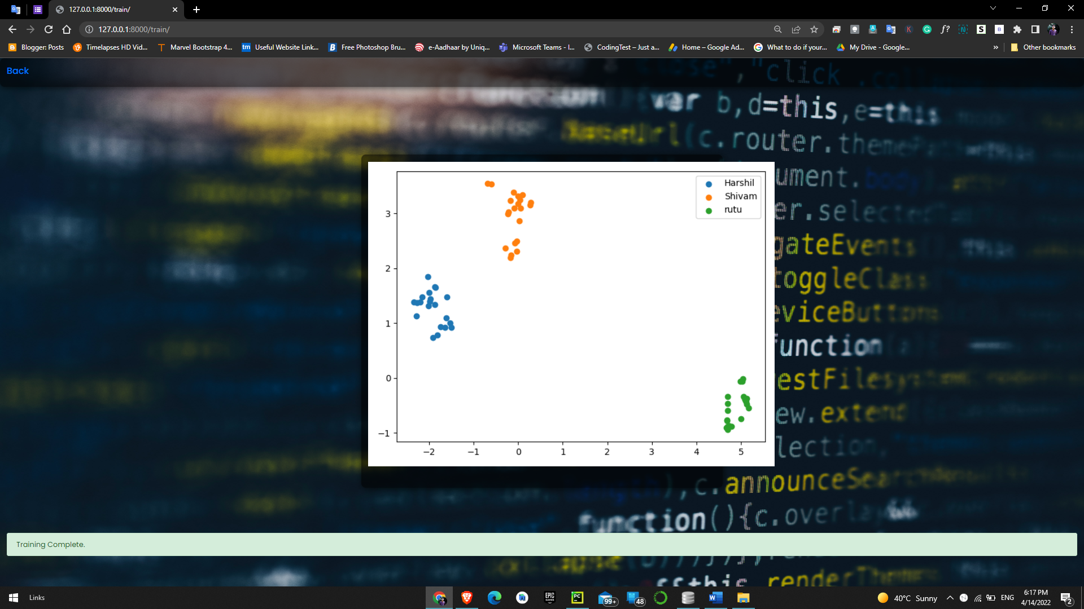
Trained Dataset Output

Slide 39
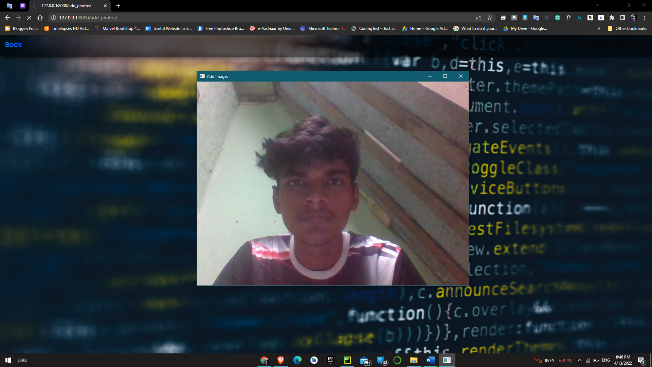
Add Photos

Slide 40
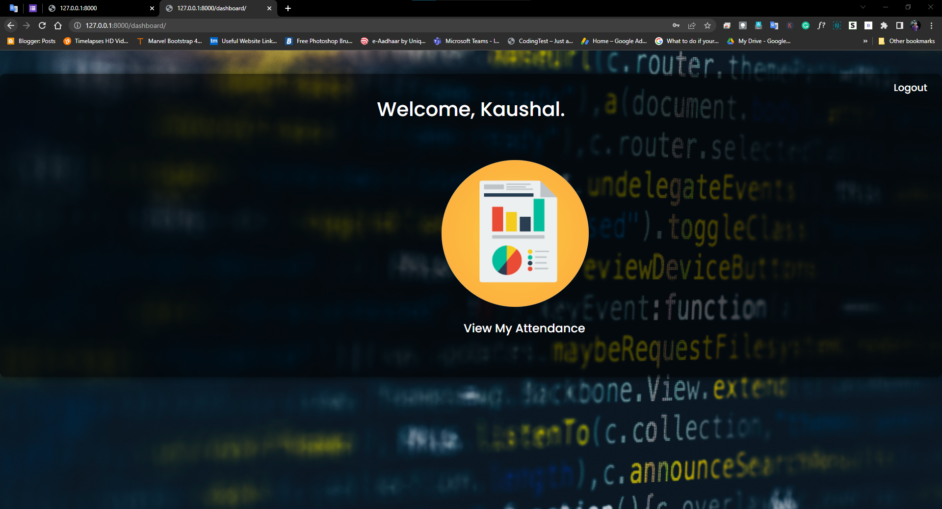
Employee Dashboard

Slide 41
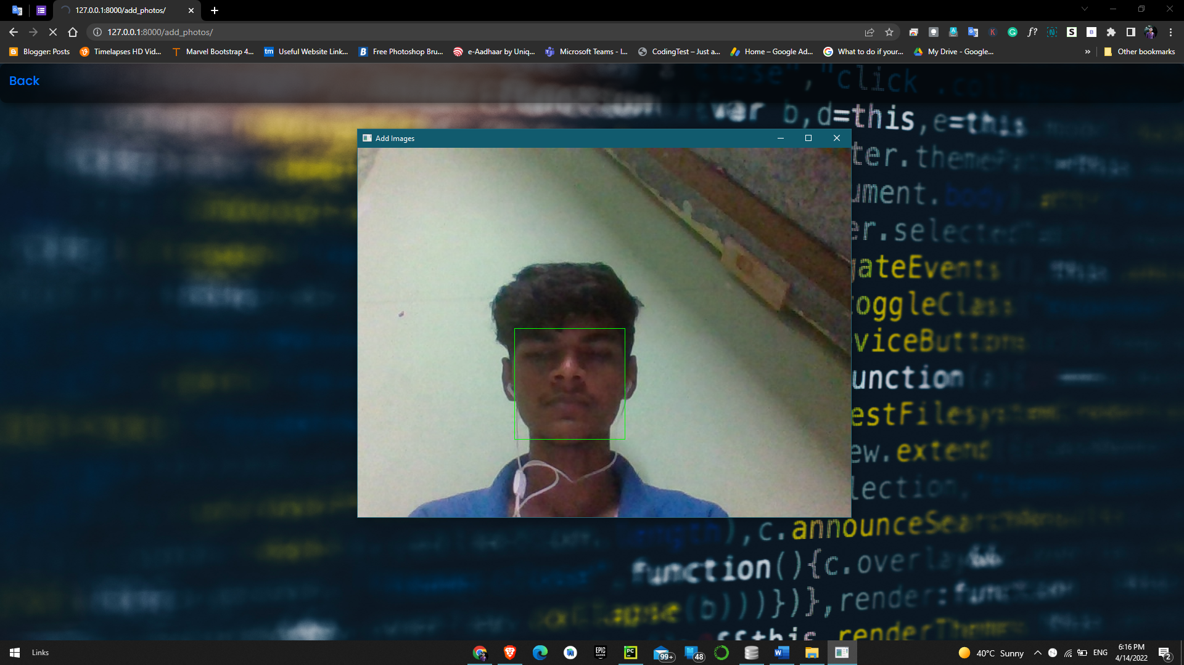
View My Attendance By Employee

Slide 42
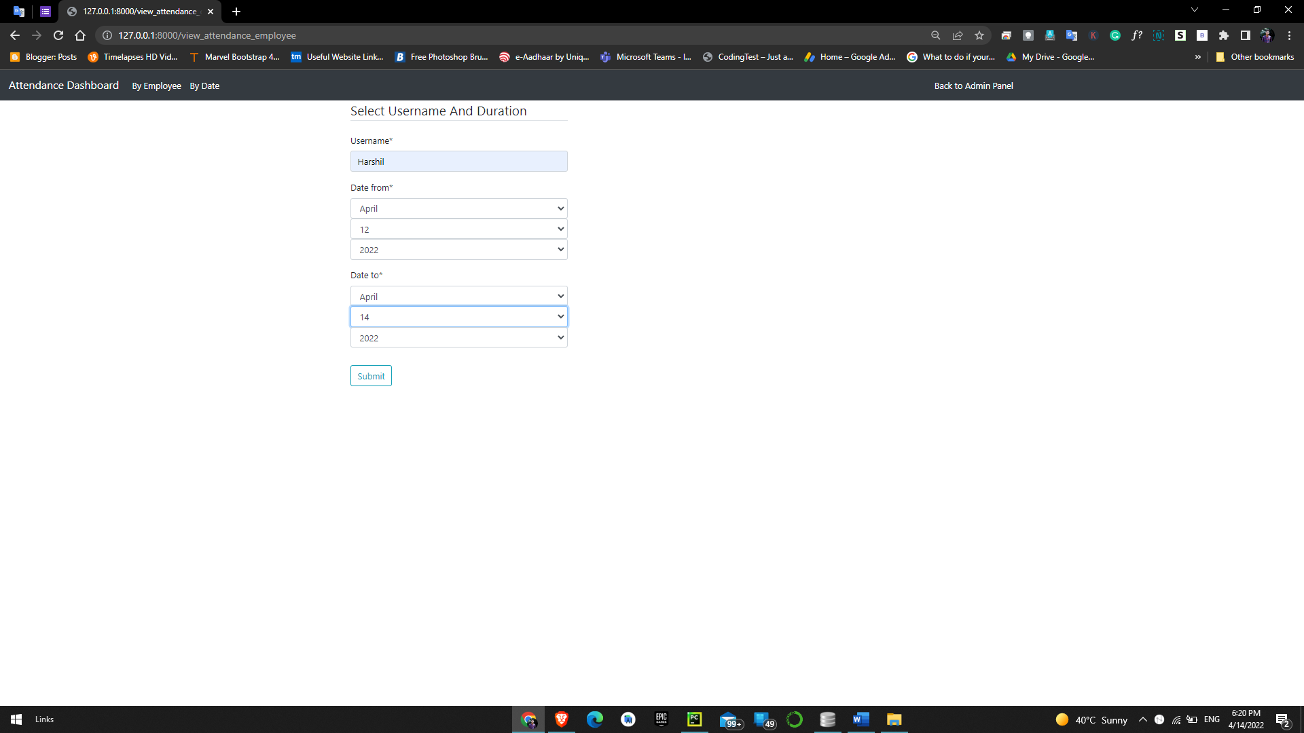
Admin can filter attendance by employee / by date

Slide 43
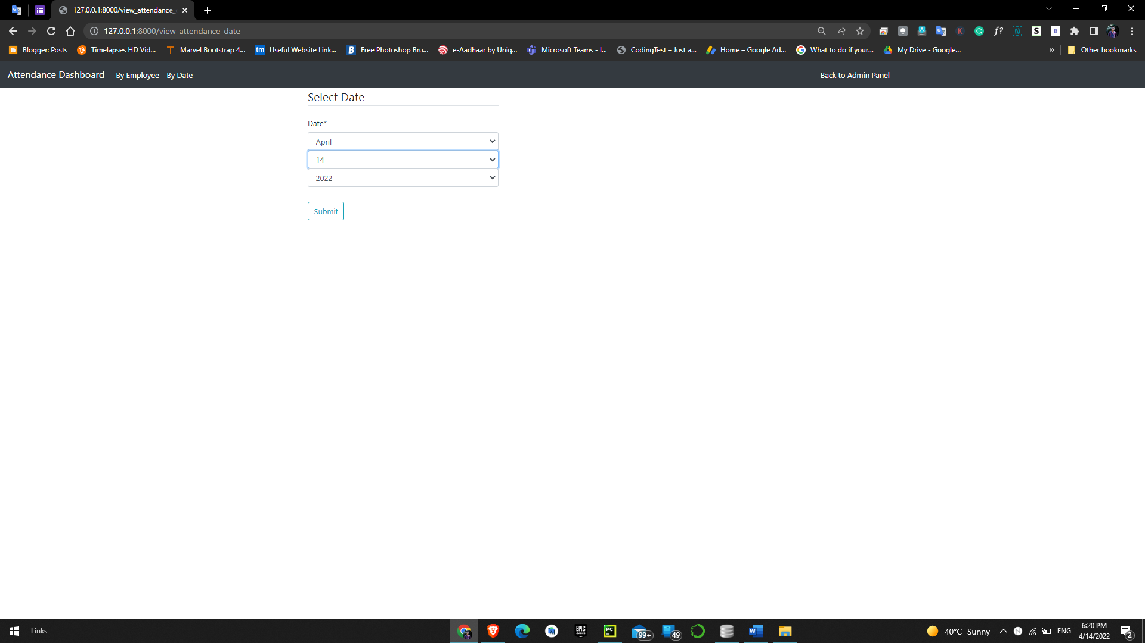

Slide 44
Conclusion
Functionality implemented successfully
- Registration
- Login / Logout
- Manage User Profile
- View My Attendance
- View Attendance by Date
- View Attendance by Employee
- Manage Attendance
- Mark my attendance In
- Mark my attendance Out
- Add photos
- Add new employee
- Train the system
- View Attendance record by date
- View no. of employee present today
- View Total number of employees

Slide 45
Limitation and Future Enhancement

Slide 46
Limitation
Attendance can be marked if the picture of an employee is shown300 images of each employee are taken for better accuracy. 20 Images per employee in a larger organization would consume a massive volume to store the images.
The training time for our classifier takes about 20 seconds for each person. Hence for a large number of employees, it would take a very long time to train. Though training the classifier isn’t something that needs to be frequently done, but it would be better if a classifier taking lesser time while maintaining the accuracy can be built.
The current model is 99.38% Accurate

Slide 47
Functionalities not implemented
Alert System
Forgot Password
Email Notifications

Slide 48
Possible future extensions
A feature which can give intruder alert can be included in the system. Furthermore, the images of unknown people can be saved in an efficient manner and displayed in the system for better security.
The number of training images can be reduced so that less storage is required. This can be done by removing duplicate images of the same person, or images with similar embeddings.
The training time can be reduced by retraining the classifier only for the newly added images.
A feature can be added where an employee is automatically sent a warning if his attendance or working hours are below the threshold.
Wrongly classified images can be added to the training dataset with the correct label so as to increase the accuracy of the recognition model.

Slide 49
References
https://www.djangoproject.com/
https://medium.com/
http://dlib.net/
https://opencv.org/
CSS & Bootstrap
https://getbootstrap.com/
For debugging
https://stackoverflow.com/

Slide 50
THANK YOU

